Slide 1
2. CHANGE MANAGEMENT MODELS
Overview of change management
Organizational change Process
Challenges in organizational change
Forces Driving Change
Types of Organizational Change (Incremental vs. Transformational),
Leadership Challenges in Change Management
Models - Lewin's Change Management Model
Kotter's 8-Step Change Model
McKinsey 7-S Model
ADKAR Model, and Bridges' Transition Model
Competing Values Framework
Role of leadership in change management
Strategies for successful change implementation

Slide 2


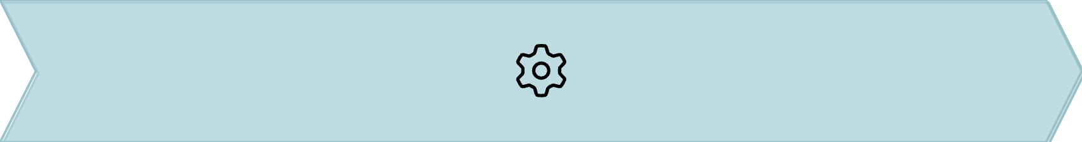

Overview of Change Management
Change management is a structured approach to guiding individuals, teams, and organizations through transitions from their current state to a desired future. Its primary purpose is to minimize resistance and maximize adoption, ensuring successful outcomes.
Awareness
Planning
Understanding the need for change.
Strategizing the approach and steps.
Implementation
Reinforcement
Executing the change initiatives.
Sustaining the change long-term.
Reference: Sengupta (2018); Nilakant & Ramnarayan (2024).

Slide 3






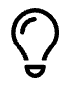



Overview of Change Management & Process
Change management is a structured approach to transitioning an organization from its current state to a desired future state, ensuring smooth adoption and sustainable outcomes.
Its primary objectives are to reduce resistance, build active adoption, and sustain the implemented changes over the long term.
2. Diagnose Current State
Conduct thorough analysis to understand existing processes, challenges, and organizational readiness.
1. Recognize Need
Identify the clear drivers and urgency behind the necessity for organizational change.
3. Plan Change
Develop comprehensive strategies, detailed action plans, and allocate necessary resources.
5. Monitor & Reinforce
Track progress, gather feedback, and establish mechanisms to embed the new processes and culture.
4. Implement
Execute the change initiatives with careful communication, training, and ongoing support for stakeholders.
References: Sengupta (2018); Nilakant & Ramnarayan (2024).

Slide 4



Forces Driving Organizational Change
Organizations rarely stand still; they are constantly influenced by various forces that necessitate change. These drivers can originate from both outside and within the organization, shaping its strategic direction and operational evolution.
External Drivers
Internal Drivers
Forces beyond the organization's direct control, often acting as catalysts for transformation.
Pressures and opportunities arising from within the organization itself, often reflecting strategic choices.
Market competition: New entrants, shifting customer preferences.
Leadership vision: New strategic direction or mission.
Workforce changes: Demographics, skills gaps, employee expectations.
Technological disruption: AI, automation, digital platforms.
Globalization: Interconnected markets, diverse consumer
bases.
Organizational culture: Need for improved collaboration, innovation, or efficiency.
Regulatory pressures: New laws, compliance requirements.
Innovation drive: Development of new products, services, or processes.
Social/environmental expectations: Sustainability, corporate social responsibility.
Reference: Scott & Jaffe (2017).

Slide 5


Types of Organizational Change
Organizational change can be categorized by its scope and impact, ranging from small, continuous improvements to radical, company-wide overhauls.
Incremental Change
Transformational Change
Gradual, continuous improvements that refine existing processes or systems for optimization (e.g., process automation).
Radical, organization-wide shifts fundamentally altering business models, culture, or strategy (e.g., digital transformation).
Process automation
Digital transformation
Workflow updates
Major restructuring
Minor policy adjustments
Mergers & Acquisitions
Reference: Singh (2024).

Slide 6
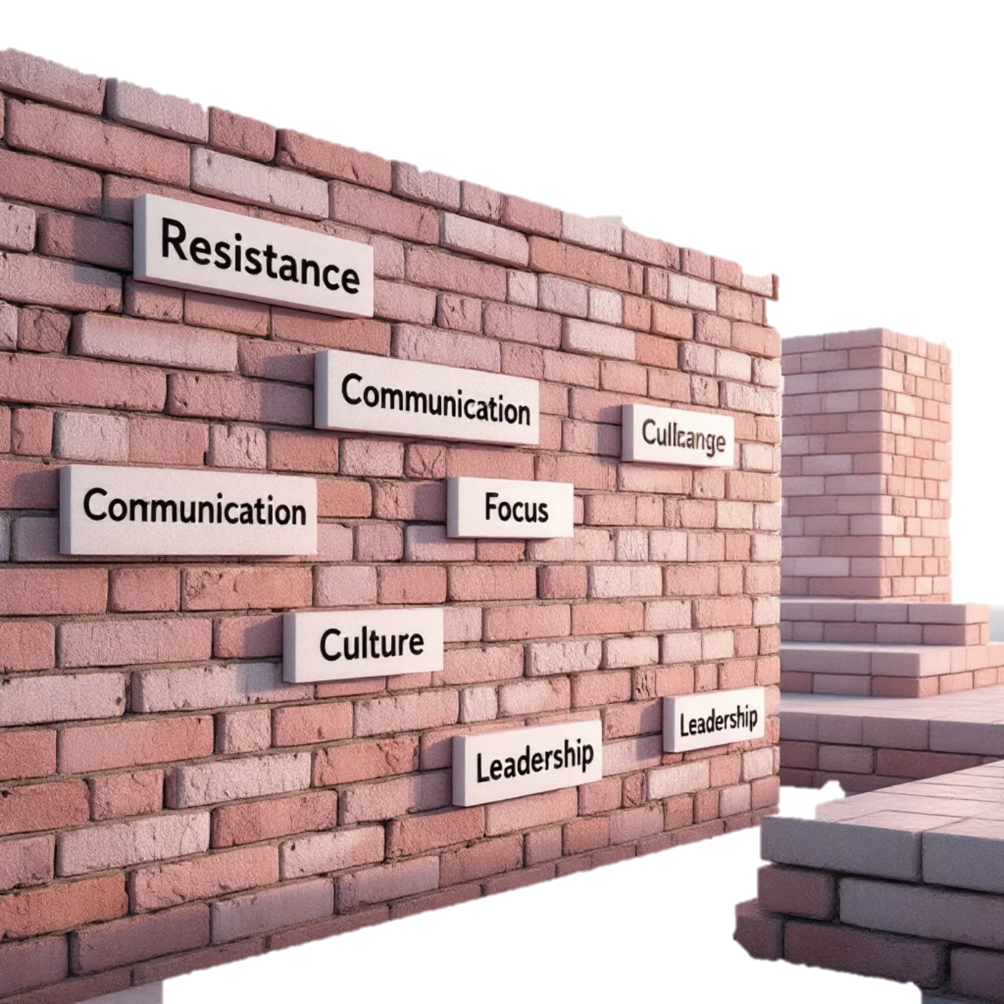
Challenges in Change Management
Navigating organizational change is rarely straightforward. Several common obstacles can impede successful transformation, requiring careful anticipation and strategic mitigation.
Resistance to Change: Employees may fear the unknown, loss of status, or increased workload.
Poor Communication: Lack of clarity, transparency, or consistent messaging can lead to confusion and distrust.
Short-term vs. Long-term Focus: Immediate pressures can overshadow the sustained effort required for lasting change.
Misaligned Organizational Culture: An existing culture that doesn't support the new direction can actively undermine efforts.
Lack of Leadership Commitment: Inconsistent support or visible disengagement from leaders can derail initiatives.
Reference: Sengupta (2018).

Slide 7
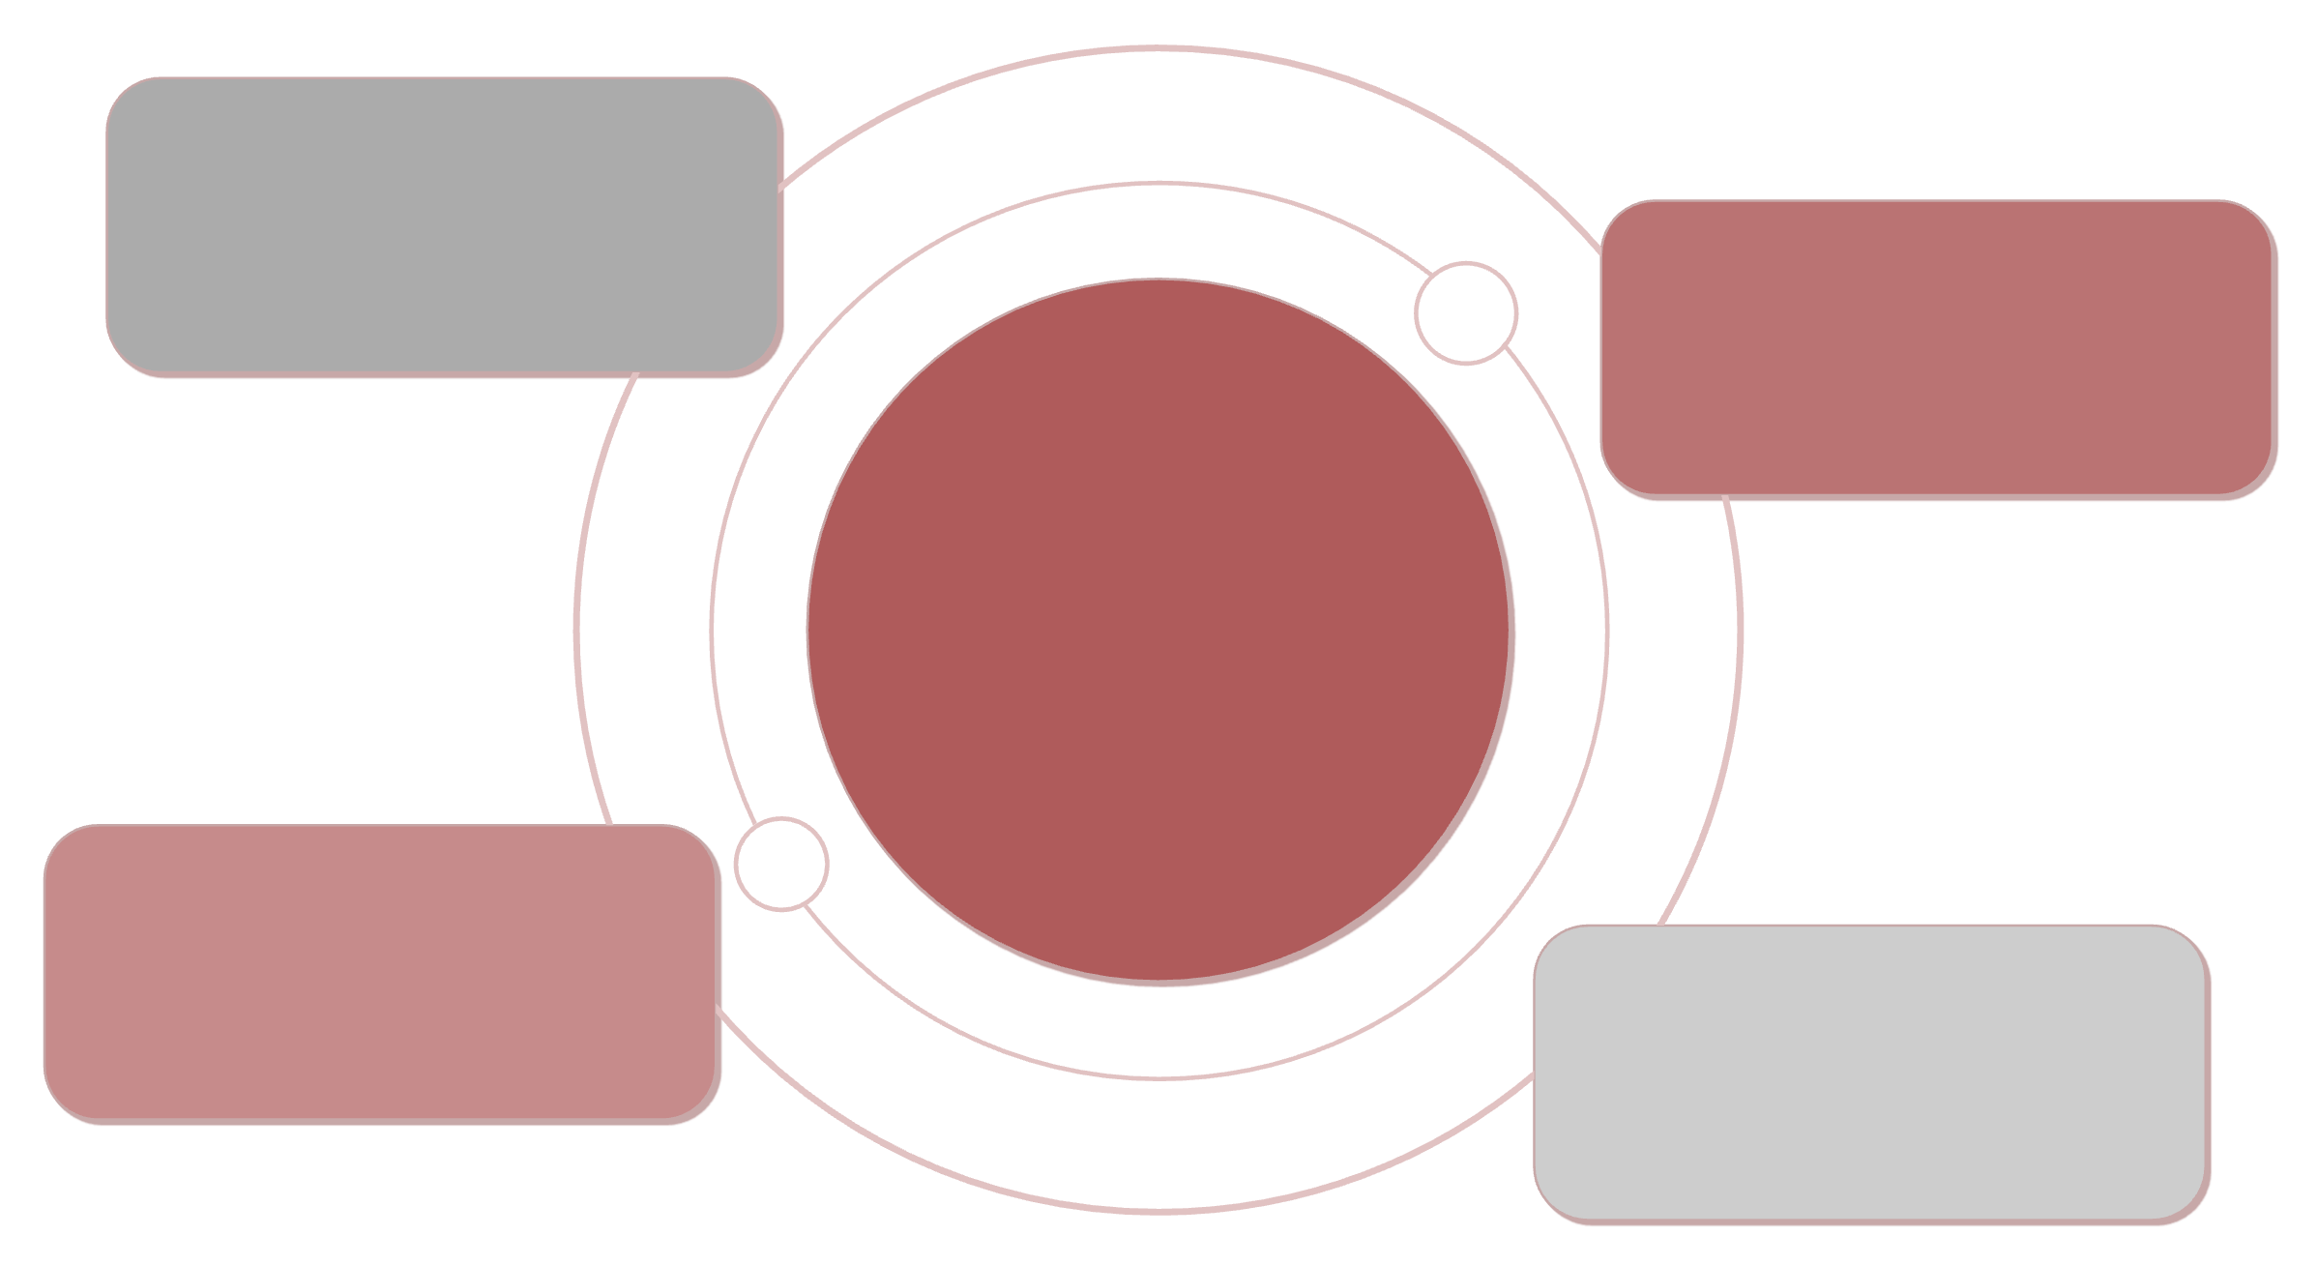
Leadership Challenges in Change
Effective leadership is paramount for successful change initiatives, but leaders frequently encounter distinct hurdles that require strategic navigation and resilient execution.
Inspire Urgency
Communicate vision and why now
Manage Resistance
Navigate uncertainty and pushback
Leadership
Guiding change through strategic, resilient leadership
Align Behaviors
Model and reinforce leadership actions
Sustain Momentum
Embed progress and celebrate wins
Reference: Case-based insights from HBR.

Slide 8



Lewin's Change Management Model
Kurt Lewin's classic three-stage model provides a foundational framework for understanding and managing organizational change. It posits that successful change involves three distinct phases, moving an organization from its current state to a desired future state.
Unfreeze
Change
Refreeze
Prepare the organization for change by challenging existing norms, identifying the need for change, and creating a sense of urgency. This stage involves breaking down old habits and mindsets.
Implement the actual changes. This phase involves introducing new behaviors, processes, structures, or technologies, often accompanied by training, communication, and support to guide individuals through the transition.
Stabilize the new state by reinforcing the changes and integrating them into the organizational culture. This prevents a return to old ways and ensures the changes become the new normal through formal and informal mechanisms.
This model emphasizes that change is not a single event but a process requiring careful preparation and reinforcement.
Strengths
Limitations
Simple and practical to understand.
Assumes linear, predictable environments.
Provides a clear, sequential approach.
Less suitable for continuous or radical change.
Focuses on preparation and stabilization.
May oversimplify complex human behavior.
Reference: Lewin (1947); Schein (1996).

Slide 9
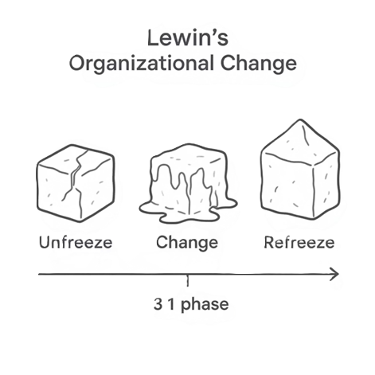
Lewin's Model: Key Takeaways
Kurt Lewin's foundational model offers a simple yet powerful framework for understanding and guiding organizational change through three essential phases:
Unfreeze
Prepare the organization by creating a sense of urgency and identifying the need for change.
Change
Implement the new processes, behaviors, or structures with adequate support and communication.
Refreeze
Stabilize the new state, embedding changes into the organizational culture to prevent relapse.
While celebrated for its clarity, the model is often critiqued for assuming a linear and stable environment, which may not always reflect the complexities of modern organizational change.

Slide 10
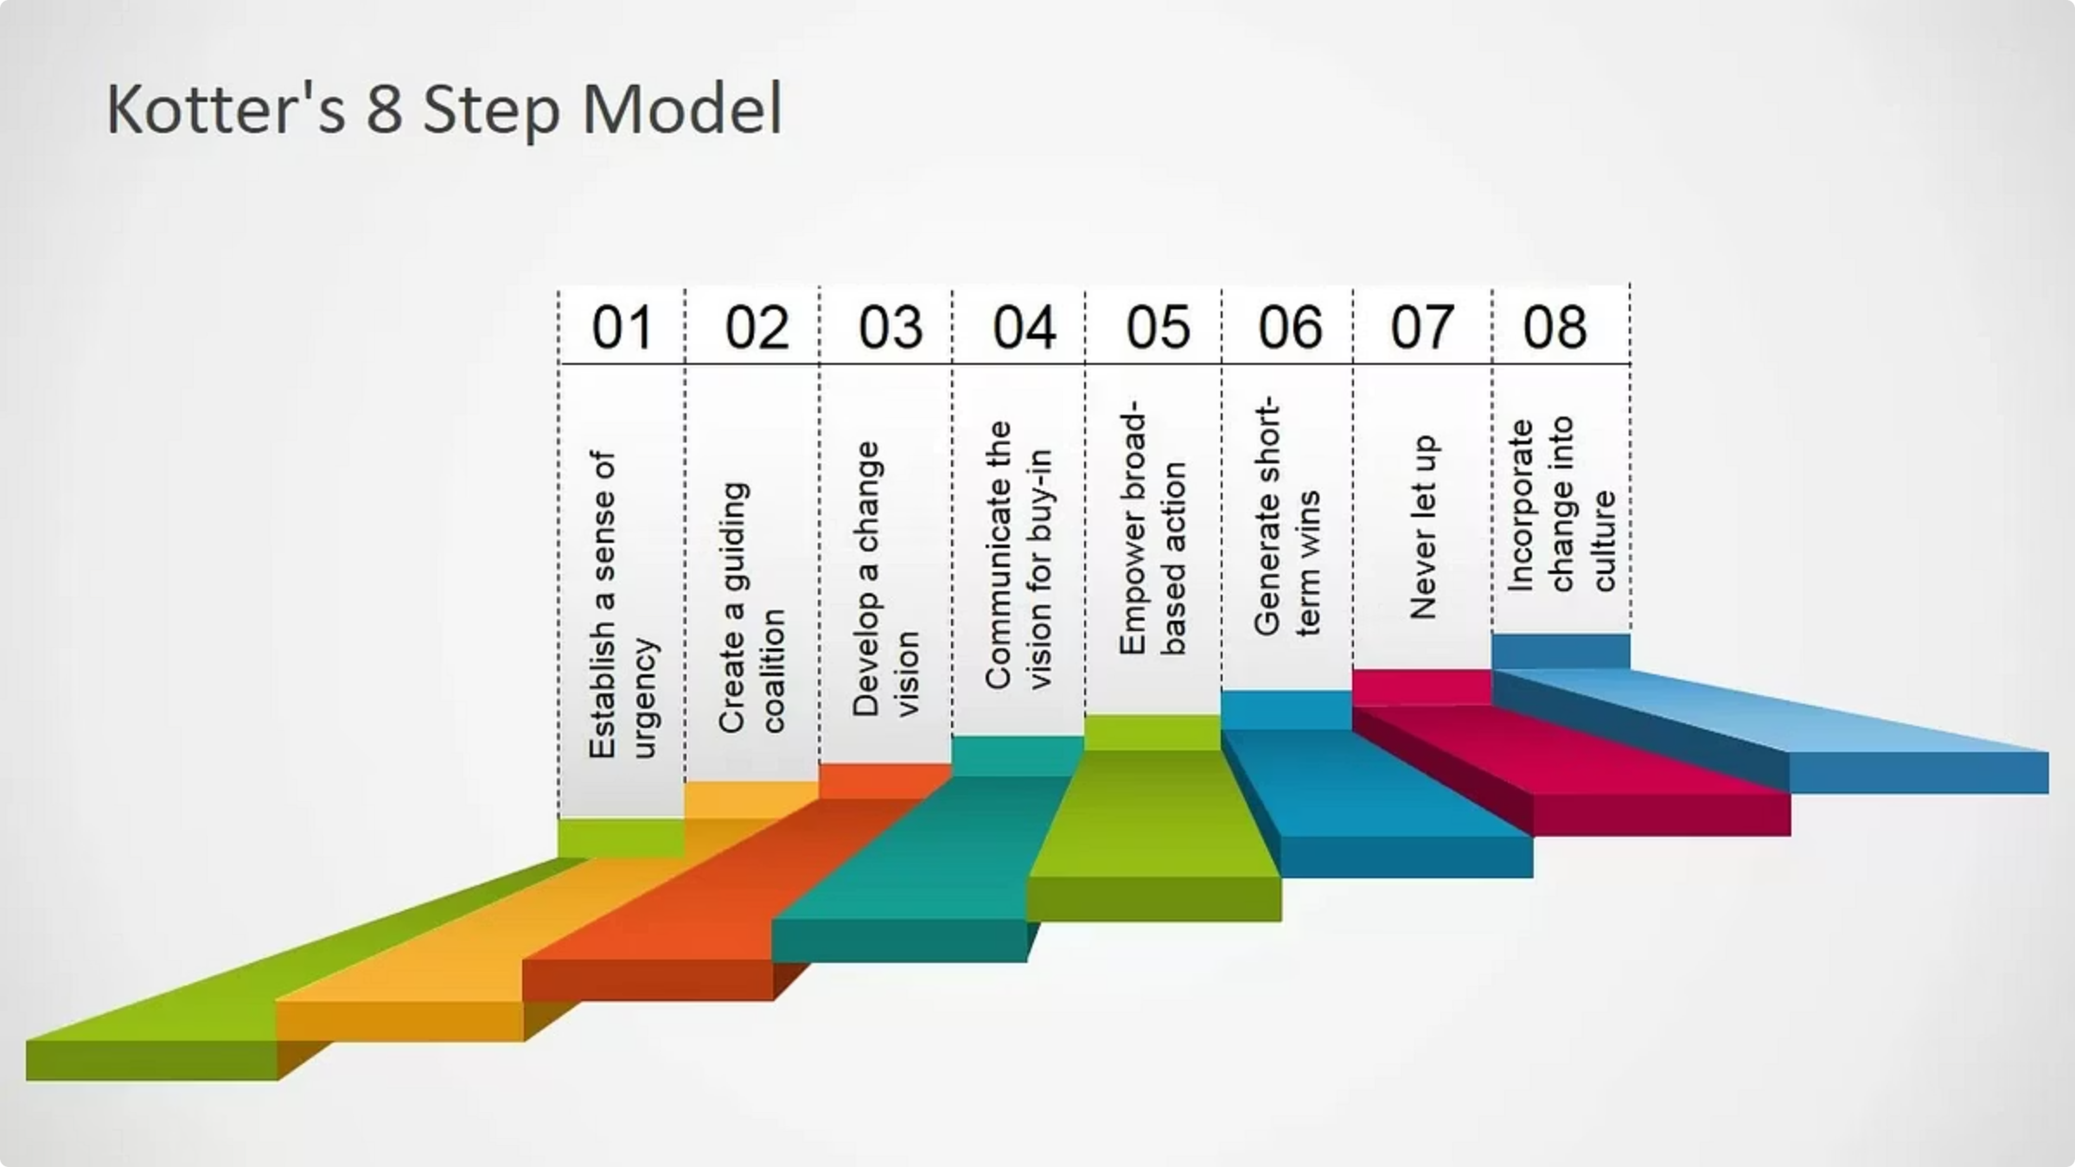
Kotter’s 8-Step Change Model
John Kotter’s influential 8-step process for leading change emphasizes a sequential, structured approach to successfully transforming organizations. It highlights critical actions leaders must take to overcome resistance and embed new practices.
Create Urgency
1
Help others see the need for change and why immediate action is critical.
Form a Powerful Coalition
2
Assemble a diverse group with enough power and influence to champion the change.
3
Create a Vision
Develop a clear, compelling vision and strategy to guide the change effort.
Communicate the Vision
4
Share the vision broadly, ensuring it is understood and accepted throughout the organization.
Remove Obstacles
5
Eliminate barriers to change and empower employees to act on the new vision.
Create Short-Term Wins
6
Plan for and celebrate visible successes to build momentum and demonstrate progress.
Build on the Change
7
Consolidate improvements, reassess strategies, and make adjustments to drive deeper change.
Anchor in Culture
8
Ensure new behaviors and practices are integrated into the organizational culture and norms.
Reference: Kotter (1996).

Slide 11
The ADKAR Model
A Framework for Individual Change Success
Developed by Prosci, ADKAR is a powerful individual-focused framework that guides people through organizational change. Unlike process-oriented models, ADKAR recognizes that successful change happens one person at a time, focusing on the personal transitions each employee must navigate.
01
02
03
Awareness
Desire
Knowledge
Understanding the need for change
Motivation to support the change
Information on how to change
04
05
Ability
Reinforcement
Skills to implement change
Sustaining the change over time
These five sequential building blocks explain what employees need at each stage to move successfully through organizational change initiatives.

Slide 12



Breaking Down the ADKAR Stages
Awareness
Desire
Knowledge
Employees must understand why the change is happening. Clear communication about business drivers, risks of not changing, and expected benefits creates the foundation for acceptance.
They must genuinely want to participate and support the initiative. Address personal motivations, concerns, and "what's in it for me" to build authentic commitment.
They must know how to change through training, resources, and ongoing support. Provide specific information about new processes, systems, and behaviors required.
Ability
Reinforcement
Employees must possess the actual skills, tools, and resources to implement change successfully. This requires practice, coaching, feedback, and time to develop new capabilities.
Leaders must ensure the change sticks through recognition, rewards, accountability measures, and celebrating wins. Without reinforcement, people often revert to old habits.

Slide 13
The McKinsey 7-S Model
The McKinsey 7-S framework is a management model that analyzes seven key internal elements of an organization to assess how well they are aligned to achieve its objectives. When all elements are in harmony, the organization is more effective.
Strategy
1
The plan developed to achieve competitive advantage and respond to changes in the external environment.
2
Structure
The way an organization is organized, including its hierarchy, departmentalization, and reporting lines.
Systems
3
The formal and informal processes and procedures that guide daily activities, from IT to recruitment.
4
Shared Values
The core beliefs and guiding principles that influence how the organization operates and how employees behave.
Style
5
The typical behaviors and leadership approach of management, including how they interact with employees.
6
Staff
The type of employees in the organization, their demographics, and how they are trained and developed.
Skills
7
The distinctive capabilities and competencies of the organization and its employees as a whole.
This model helps diagnose misalignments and guides strategic change initiatives by ensuring all elements support the desired future state.

Slide 14
McKinsey 7-S: Hard & Soft Elements
The McKinsey 7-S model categorizes organizational elements into 'Hard' and 'Soft,' both crucial for successful change and performance.
Soft Elements
Intangible, behavioral aspects that are harder to describe but crucial for sustainable organizational success.
Hard Elements
Tangible, easily defined structures that can be directly influenced by management decisions and formal documentation.
Shared Values
Guiding principles at the organization's core
Strategy
Style
Clear plans and competitive positioning
Leadership culture and management approach
Structure
Staff
Organizational charts and hierarchies
People, their motivation and development
Systems
Skills
Processes and operational workflows
Distinctive capabilities and expertise
Effective organizational change hinges on understanding and balancing both hard and soft elements for holistic alignment.

Slide 15



Bridges' Transition Model: Navigating the Human Side
While change is external and situational, transition is internal and psychological. Leaders must guide people through three distinct emotional phases to achieve lasting transformation.
Ending, Losing, Letting Go
The Neutral Zone
The New Beginning
Emotional State: Resistance, fear, denial, and loss
Emotional State: Confusion, uncertainty, low morale, but also creativity
Emotional State: Acceptance, renewed energy, commitment, optimism
What People Need: Empathy, clear communication about what's changing and why, acknowledgment of loss
What People Need: Patience, temporary systems, quick wins to build confidence
What People Need: Clear vision, reinforcement of new behaviors, recognition of progress
Leadership Actions: Listen actively, validate feelings, explain the rationale, provide support
Leadership Actions: Set short-term goals, encourage experimentation, strengthen communication, celebrate small victories
Leadership Actions: Reinforce the vision, reward adoption, build on momentum, embed new practices

Slide 16
Competing Values Framework
The Competing Values Framework provides a powerful lens for understanding organizational culture by classifying it into four distinct types. This model helps leaders identify cultural tensions and navigate them strategically when implementing change initiatives.
Understanding the Four Cultural Quadrants
Clan Culture
Adhocracy Culture
Collaborative, family-like environment focused on teamwork, participation, and consensus. Values mentoring and employee development.
Creative, entrepreneurial setting that emphasizes innovation, risk-taking, and adaptability. Thrives on experimentation and agility.
Market Culture
Hierarchy Culture
Competitive, results-oriented environment driven by achievement, goals, and external positioning. Focuses on winning and productivity.
Controlled, structured setting that values stability, efficiency, and predictable processes. Emphasizes rules and formal procedures.
Balancing Competing Tensions
Each quadrant represents values that naturally compete with others. Innovation (Adhocracy) may conflict with stability (Hierarchy), while collaboration (Clan) can tension with competitive drive (Market). Effective change leadership requires balancing these tensions and aligning cultural values with strategic objectives.

Slide 17



The Catalytic Power of Leadership in Change
Leaders don't just manage change - they ignite it. As the architects of transformation, leaders communicate vision with clarity, motivate teams through uncertainty, and embody the behaviors they wish to see throughout the organization.
Vision Communication
Team Motivation
Behavioral Modeling
Articulate the "why" behind change, painting a compelling picture of the future that resonates emotionally and intellectually with every team member.
Inspire action by connecting individual contributions to organizational goals, recognizing efforts, and maintaining energy throughout the journey.
Demonstrate desired behaviors consistently—your actions set the standard and signal that change is not optional but essential.
Transparency
Empathy
Consistent Reinforcement
Share information openly, acknowledge challenges, and maintain honesty about both progress and setbacks.
Understand the human side of change—listen actively, validate concerns, and support people through transitions.
Repeat key messages, celebrate milestones, and maintain visible commitment to build lasting trust.
"Leadership during change isn't about having all the answers - it's about building trust, showing the way forward, and empowering others to embrace the journey."

Slide 18

Strategies for Successful Implementation
Transforming vision into reality requires deliberate action and strategic engagement. Success emerges from proactive planning, continuous communication, and genuine stakeholder involvement at every stage.
01
02
03
Communicate Clearly and Frequently
Involve Stakeholders Early
Provide Training and Resources
Establish multiple channels for two-way dialogue. Share updates regularly, invite questions, and ensure messaging reaches every level of the organization.
Bring key players into the conversation from day one. Co-create solutions, leverage diverse perspectives, and build ownership through meaningful participation.
Equip your people with the skills, tools, and knowledge they need. Invest in comprehensive development programs that build confidence and capability.
04
05
Address Resistance Through Dialogue
Monitor Progress and Celebrate Quick Wins
Listen to concerns without judgment. Understand the root causes of resistance and respond with empathy, facts, and genuine solutions.
Track metrics that matter, adjust course as needed, and recognize achievements—no matter how small. Momentum builds on visible success.
Key Insight: Implementation isn't a one-time event—it's an ongoing process of adaptation, learning, and refinement. Stay flexible, remain committed, and keep your teams engaged throughout the transformation.

